Slide 1
Free Monad and
Free Applicative

Slide 2
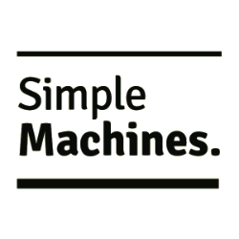
Cameron Joannidis
FP, Data Engineering, Machine Learning

Slide 3
Cameron Joannidis
FP, Data Engineering, Machine Learning
We are hiring!

Slide 4
Motivation - Domain Description
Assume domain is “pure” - i.e. no effects
Simple User as the domain entity
Functions that act on that entity
User Creation
Retrieving User By Identifier
List All Users

Slide 5
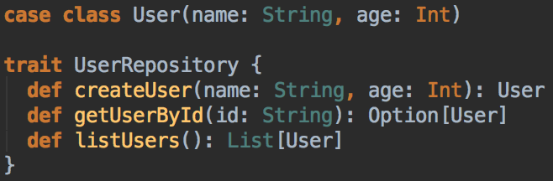
Motivation - Domain Code

Slide 6
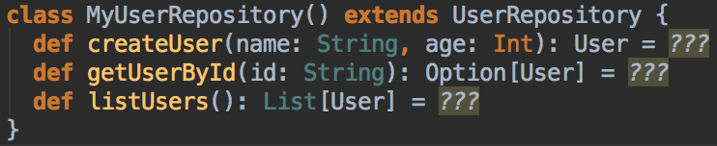
Motivation - Domain Code

Slide 7
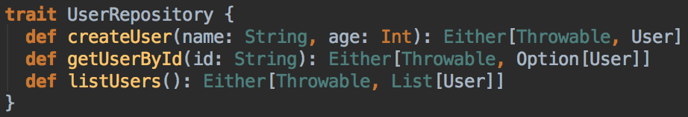
Motivation - Domain Code

Slide 8
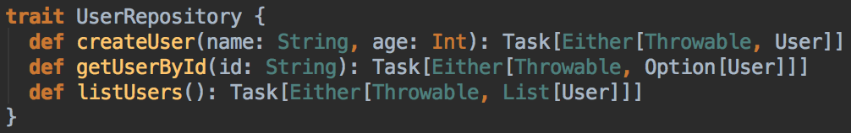
Motivation - Domain Code

Slide 9
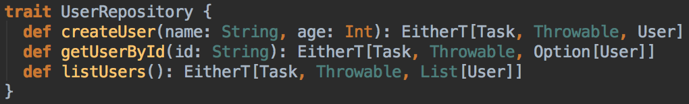
Motivation - Domain Code

Slide 10


Slide 11
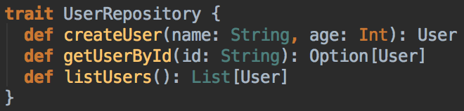
What happened to our domain?!
Initially
Now:

Slide 12
The problem
We are mixing our domain with the implementation effects

Slide 13
The problem
We are mixing our domain with the implementation effects

Slide 14
The problem
Tightly couples our domain to its effects
Means that we need to test against this interface (and thus either stub/mock out effects or test with actual effects). Ultimately - we can’t isolate our domain.

Slide 15
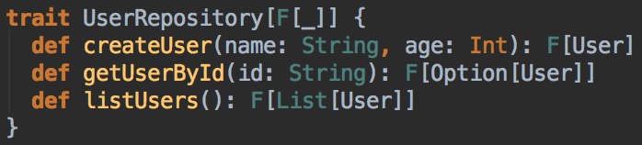
Let’s abstract out the effect

Slide 16
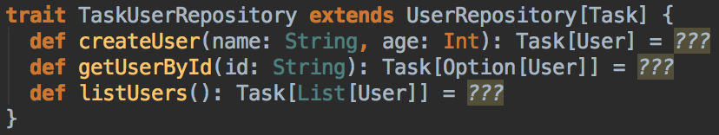
And Implement the interface

Slide 17
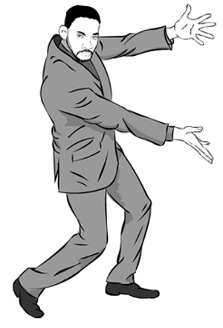
FINAL TAGLESS

Slide 18
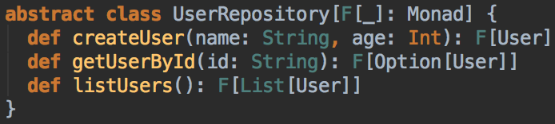
Constraining the effect - Option 1

Slide 19
Constraining the effect - Option 1

Slide 20
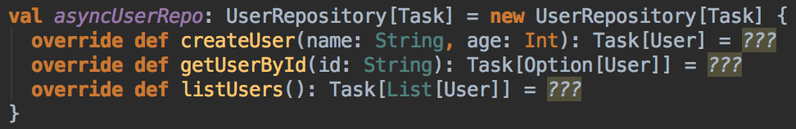
Constraining the effect - Option 2

Slide 21
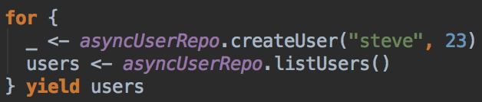
Constraining the effect - Option 2

Slide 22
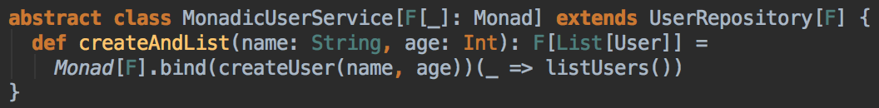
Constraining the effect - Option 3

Slide 23
Limitations?
Provide constraints on the interface as to how the domain will be used (in this case “monadically”)

Slide 24
Limitations?
Provide constraints on the interface as to how the domain will be used (in this case “monadically”)
Tightly couples our domain with the execution constraints

Slide 25
Limitations?
2. Choose a concrete effect type and write our program in terms of our effect

Slide 26
Limitations?
2. Choose a concrete effect type and write our program in terms of our effect
Our program is then tightly coupled with the effect type implementation details. This may not be a problem pragmatically in a lot of cases though.

Slide 27
Limitations?
3. Subclass our domain to provide constraints (e.g. service approach)

Slide 28
Limitations?
3. Subclass our domain to provide constraints (e.g. service approach)
Require an implementation per subclass for applicative vs. monad etc. Duplicated effort.

Slide 29
Enter Free

Slide 30
Free - Why use it over Final Tagless?
Achieves a very similar goal as final tagless of separating domain from effect, but goes a little bit further and allows your domain to be declared ENTIRELY separate to your effects.
Reifies your domain.
Allows us to optimise/map/summarise/etc our programs since they are just data

Slide 31
Free
Declare your domain as data (case classes)
Declare your domain functions as data (case classes)
Lift your domain functions into a Free structure that constrains its effect
Write your program in terms of the Free structures
Interpret your domain functions to produce output (Interpreter Pattern)

Slide 32
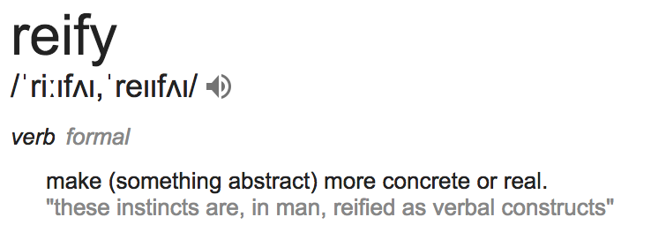
Reify?

Slide 33
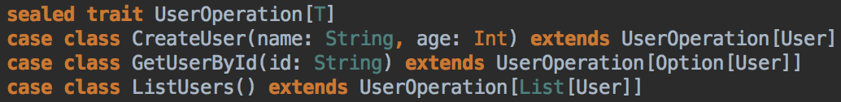
Domain Functions as Data

Slide 34
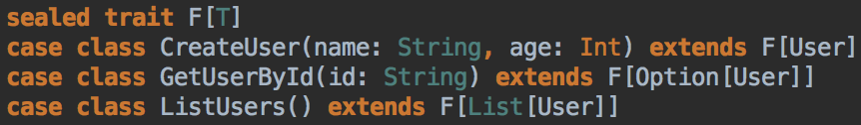
Domain Functions as Data

Slide 35
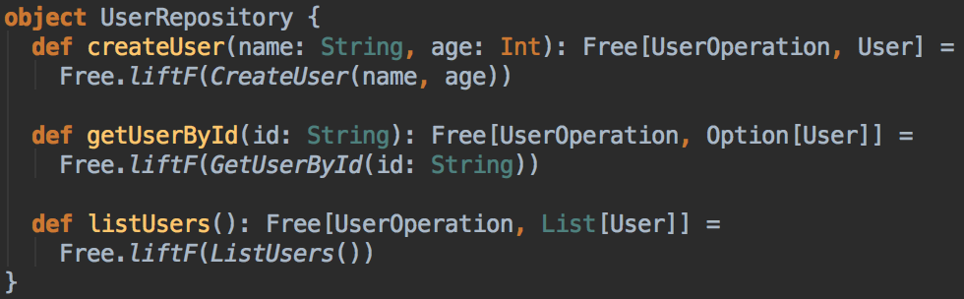
Choosing constraints on the effect via “Lift”ing

Slide 36

Let’s break it down
Lift our domain operations into the Free Monad
Implicitly enforce “monadic” constraints on our effect (in this case named UserOperation)
Reified our domain (our domain functions are captured in the Free Monad as simple case classes)

Slide 37
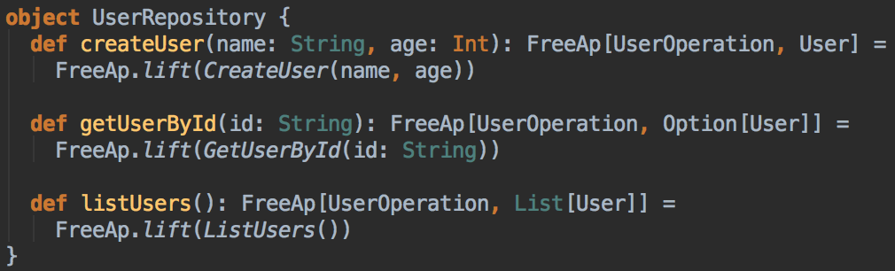
Applicative Effect Constraint

Slide 38
Free Applicative
Instead of lifting our domain into the Free Monad, we lift it into the Free Applicative.
Enforces constraints on the effect - not the domain of an Applicative.

Slide 39
Time for a more realistic example

Slide 40
Let’s smash Monads and Applicatives together!

Slide 41
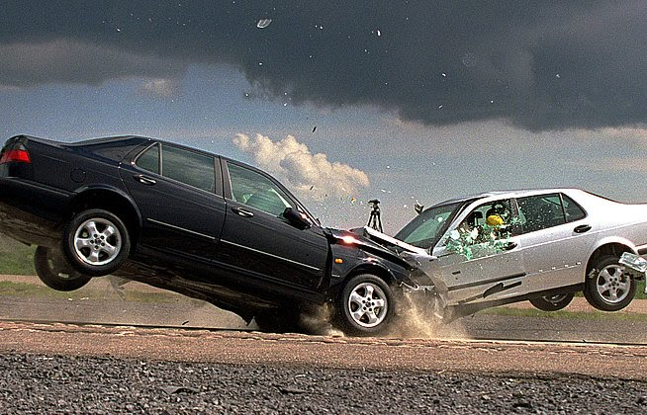
FREE
FREEAP

Slide 42
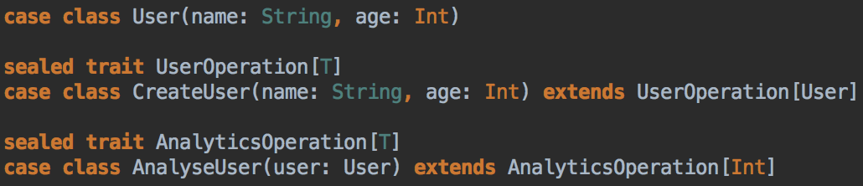
Let’s define two simple domains

Slide 43
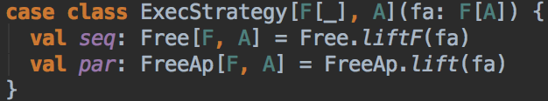
Simple abstraction layer

Slide 44
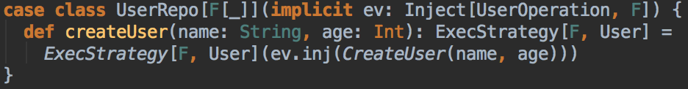
Lift our domain

Slide 45
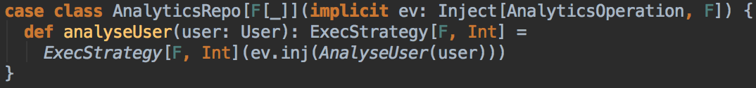
Lift our domain

Slide 46
Combining Free and FreeAp - Option 1

Slide 47
Combining Free and FreeAp - Option 1

Slide 48
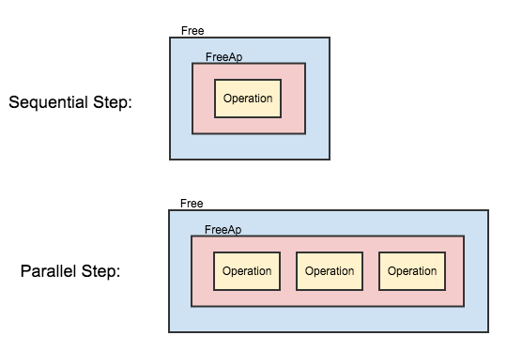
Combining Free and FreeAp - Option 1

Slide 49
Combining Free and FreeAp - Option 2

Slide 50
Combining Free and FreeAp - Option 2

Slide 51
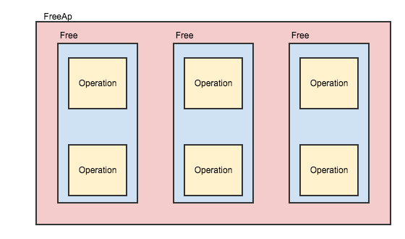
Combining Free and FreeAp - Option 2

Slide 52
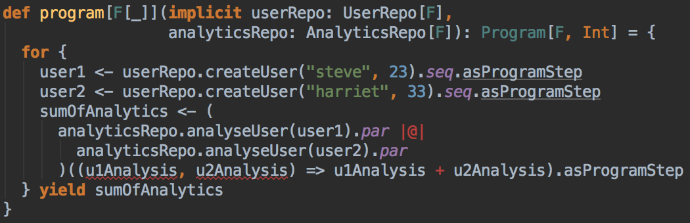
Writing our program - Example 1

Slide 53
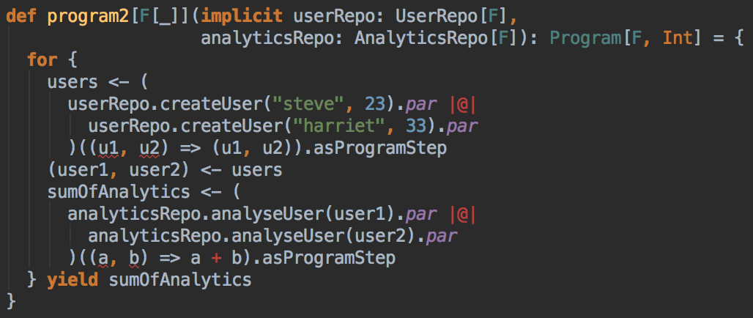
Writing our program - Example 2

Slide 54
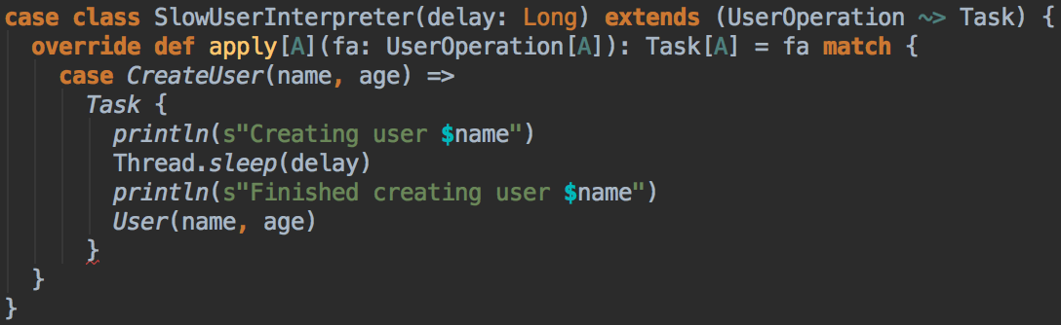
Defining Interpreters

Slide 55
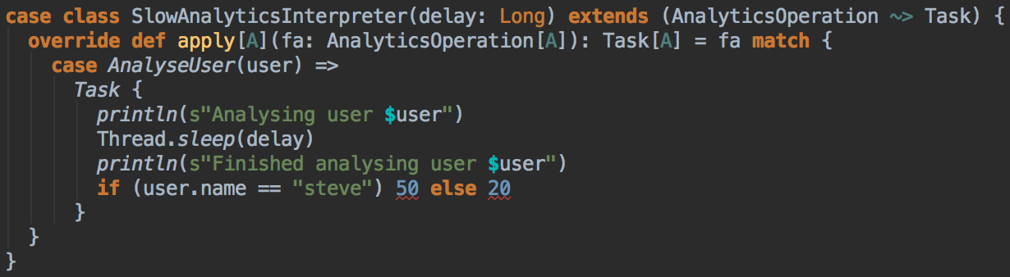
Defining Interpreters

Slide 56
Running the program

Slide 57

Running the program
A bit of boilerplate to enable our program to interpret both the Free and the FreeAp operations

Slide 58
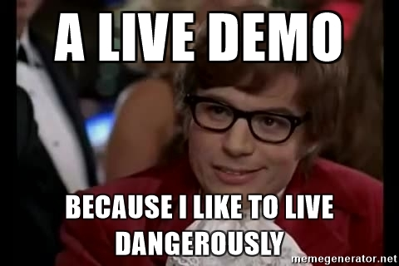
Time for a quick demo
*heart rate quickens*

Slide 59
General Limitations of Free
Reification means that each instruction is interpreted at runtime. Minor overhead but if you’re doing super low latency stuff - measure it and see if it’s actually a problem.
Boilerplate of lifting domain into Free structures and running (mostly only written once - so minimal issue in actual use. If it’s a problem there are frameworks that auto-generate most of this boilerplate).

Slide 60
Common Concerns
Too complex to use?
Too hard for new devs to understand?
Too slow?
Too much boilerplate?

Slide 61
Questions?

